Slide 1
Adiposity and methylation
Guannan Shen
ECCHO Project
11-07-2018

Slide 2
Data sets and sample size
The total sample size is 583 individuals.
3 Datasets:
Clinical dataset contains:
pid, infant_sex, maternal_age, Race
"birth_weight", "ipv3_pp_fm_pct", "Chol_IPV3", "FFA_IPV3", "Gluc_IPV3", "HDL_IPV3", "Insu_IPV3", "Trig_IPV3" and "Leptin_actual__ng_ml_".
Cord blood cell types:
"Bcell", "CD4T", "CD8T", "Gran", "Mono", "NK", "nRBC"
Top One CpG in FDR < 0.05 DMRs, by gender:
Male: 103 CpGs
Female: 38 CpGs

Slide 3
Variables
Log10 transformation of all 9 outcomes.
Race as a 2-level categorical variable:
Non-Hispanic white, All others.

Slide 4
Data ANLYSIS
The parsimonious linear regression model:
Outcome = One CpG + Race + Bcell + CD4T + CD8T + Gran + Mono + NK + nRBC
Benjamini–Hochberg (BH) step-up procedure controlling FDR (False Discovery Rate) as the p value adjustment method.
Number of multiple comparisons:
Male: 103
Female: 38

Slide 5
Significant Results By gender

Slide 6
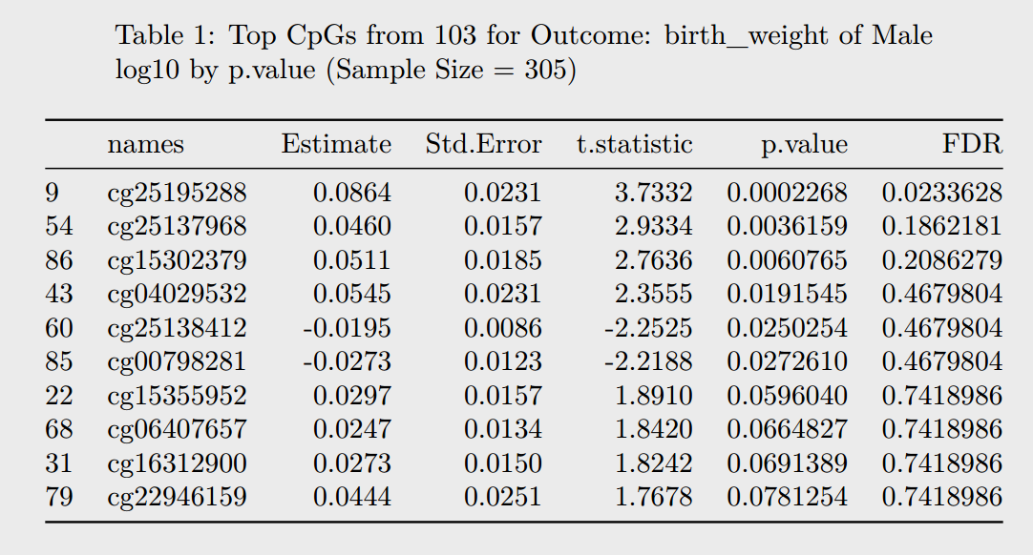
Male
names Estimate Std.Error t.statistic p.value FDR
9 cg25195288 0.0864 0.0231 3.7332 0.0002268232 0.02336279

Slide 7
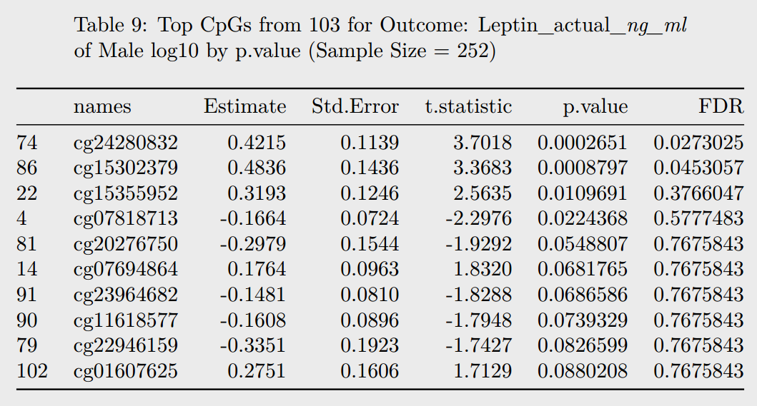
Male
names Estimate Std.Error t.statistic p.value FDR
74 cg24280832 0.4215 0.1139 3.7018 0.0002650726 0.02730247
86 cg15302379 0.4836 0.1436 3.3683 0.0008797220 0.04530568

Slide 8
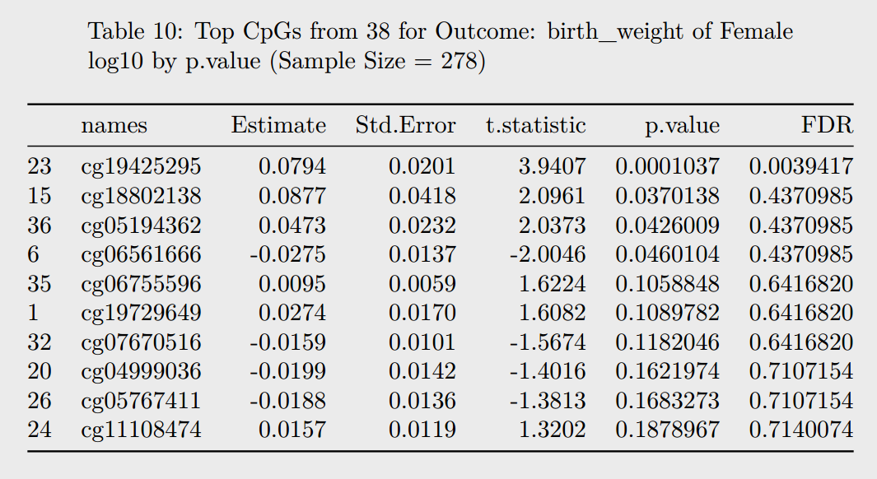
FEMALE
names Estimate Std.Error t.statistic p.value FDR
23 cg19425295 0.0794 0.0201 3.9407 0.0001037282 0.003941671

Slide 9
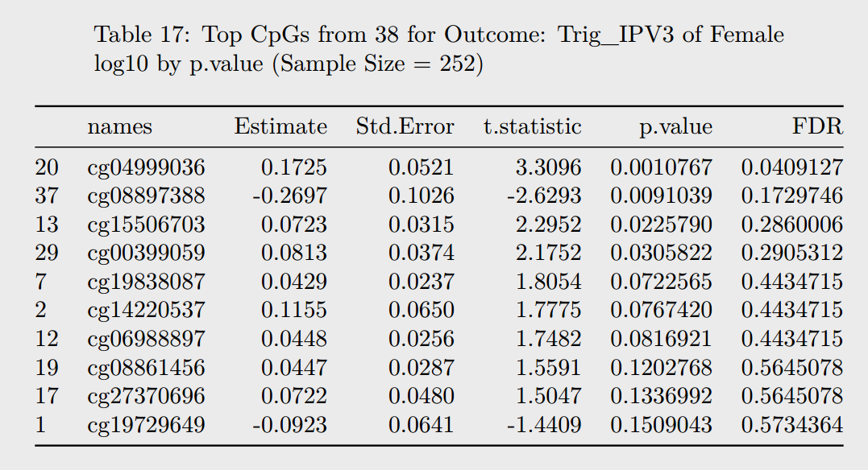
FEMALE
names Estimate Std.Error t.statistic p.value FDR
20 cg04999036 0.1725 0.0521 3.3096 0.001076651 0.04091274

Slide 10
Method Section
Separate linear regression models were fitted to estimate the associations between continuous PFOA and methylation (M-values) at each of 484,261 CpG sites. Models were adjusted for maternal race/ethnicity (non-Hispanic white vs all others) and seven cell types. Analyses were stratified by infant sex a priori based on previous literature showing sex-specific effects of prenatal PFAS on child health outcomes.
Genes associated with the list of 500 top CpGs were analyzed in relation to KEGG pathways, and DMRs were entered into the GREAT tool to examine enrichment of GO pathways.
Within each differentially methylated region with FDR<0.05, the CpG site with the lowest p-value was identified, and methylation (M value) at this site was examined in association with birth weight, adiposity, and several cardio-metabolic biomarkers measured in umbilical cord blood (glucose, insulin, leptin, total cholesterol, HDL cholesterol, free fatty acids, triglycerides). Outcome variables were log10 transformed to better approximate a normal distribution. Linear regression models were adjusted for maternal age and race/ethnicity, and stratified by sex. The p value of the association was adjusted by Benjamini–Hochberg (BH) method, controlling the False Discovery Rate(FDR) (Yoav Benjamini and Yosef Hochberg, 1995)

